Slide 1
HOUSE PRICING PREDICTION MODEL USING LINEAR REGRESSION
PYTHON DATA ANALYSIS PROJECT
CATHERINE FIONA

Slide 2
PROBLEM STATEMENT
The objective of this project was to analyze factors influencing house prices and build a predictive model using linear regression to estimate house prices based on property features

Slide 3
LIBRARIES AND DATA SETS USED
Numpy imported as np
Pandas imported as pd
Matplotlib.pyplot imported as plt
%matplot lib inline
Sklearn.linear_model to import linear regression
sklearn.model_selection to import train_test_split

Slide 4
DATA SET OVERVIEW
The data set consisted of :
1.Baths where ½ a bath represents a sink and toilet while a full bath is inclusive of a shower.
2.Beds
3.House size in sqft
4.Lot size (size of entire compound) in sqft
5. Zip code
6. House price in dollars

Slide 5
STEP 1: IMPORTING THE DATA SET
The data set was obtained from Kaggle.com and it is from houses in boston.
The machine reads in the data once imported and using the function “data.describe()” it is able to find the count, mean ,standard deviation and the maximum and minimum

Slide 6
STEP2:DATA ANALYSIS
Here,we try to compare different aspects of the data to price in an attempt to draw relationships between them.
Different mathematical methods are employed to graphically deduce the relationship of the data sets

Slide 7
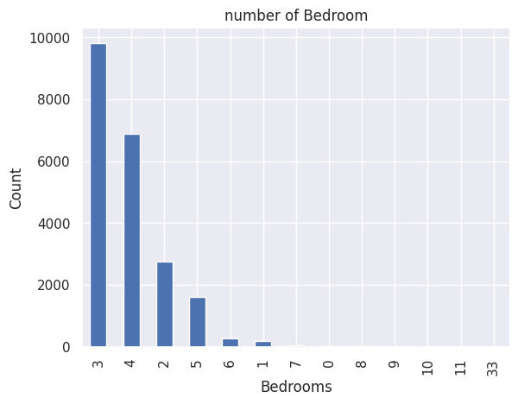
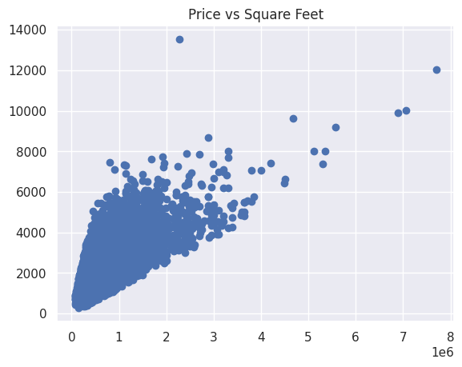
VARIOUS COMPARISONS MADE
function seaborn.utils.despine(fig=None, ax=None, top=True, right=True, left=False, bottom=False, offset=None, trim=False)>

Slide 8
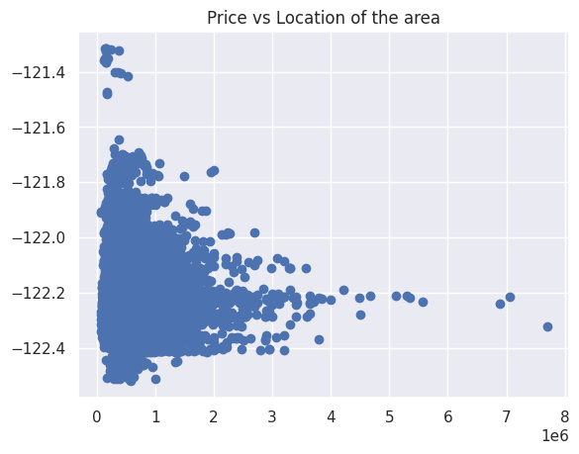
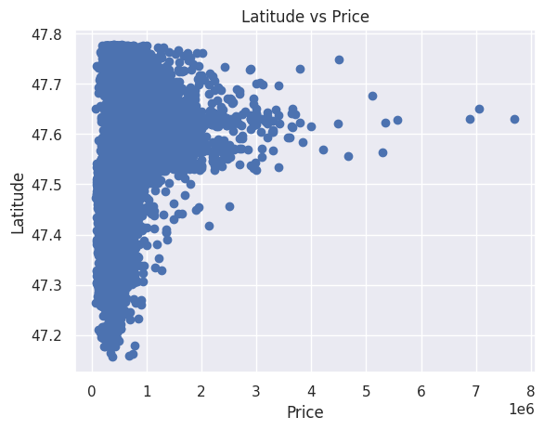

Slide 9
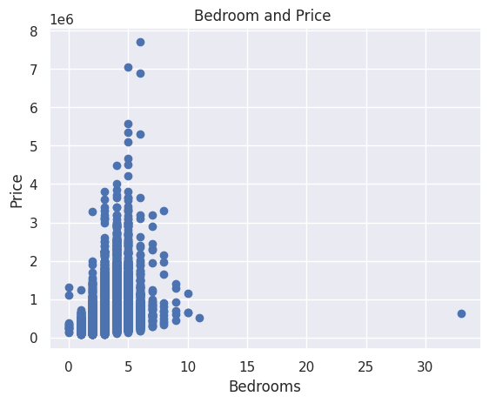
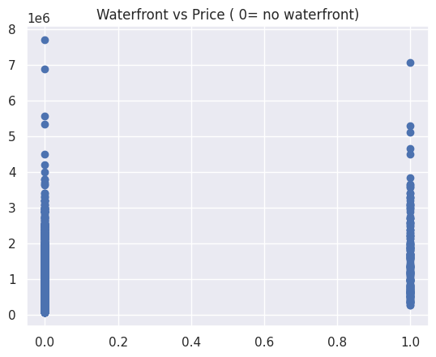

Slide 10
INTRODUCING LINEAR REGRESSION MODEL
Model used: Linear Regression
Data split: 80% training, 20% testing
Purpose: Evaluate model performance on unseen data

Slide 11
MODEL PERFOMANCE
We then fit the linear regression model onto it and we obtain the accuracy scale.
An accuracy of 85% and above is considered good whereas anything below it is considered unreliable.
Evaluation metric: R² score
Test R²: 0.73
Interpretation:
The model explains approximately 73% of the variance in house prices, indicating reasonable predictive power for a baseline model.
This can be attributed to the following
.Data read by machine may have been lost

Slide 12
.The machine may require a decision tree
.The machine requires more time to internalize the data
The accuracy can be fixed using gradient descent boosting.

Slide 13
Conclusion
This project demonstrates the use of Python for data cleaning, exploratory analysis, and predictive modeling. While linear regression provides a solid baseline, more advanced models would likely improve performance.

Slide 14
THE END

